Slide 1
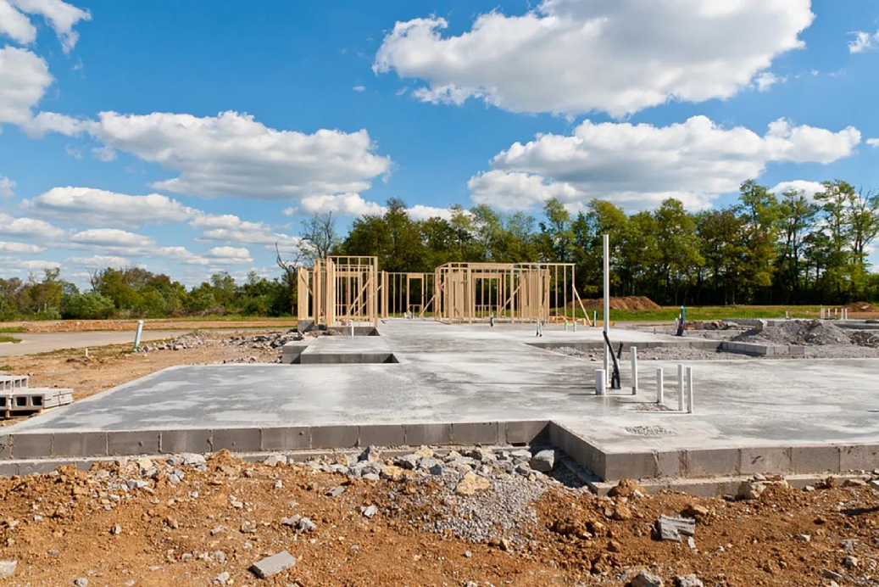
DJ Foundations
Song Prep & Basic Mixing
• What DJs actually do
• How to get started
• One clean transition
Notes:
this is a crash course designed to teach the basic workflow and essential terminology to get started DJing at home and at an open decks, this does not cover advanced theory or best practices, this course is less about the why and the how and more about giving a repeatable and digestible process with some key points to look into that will allow you to work towards those things on your own, this is the foundation that you will build your actual skills on

Slide 2
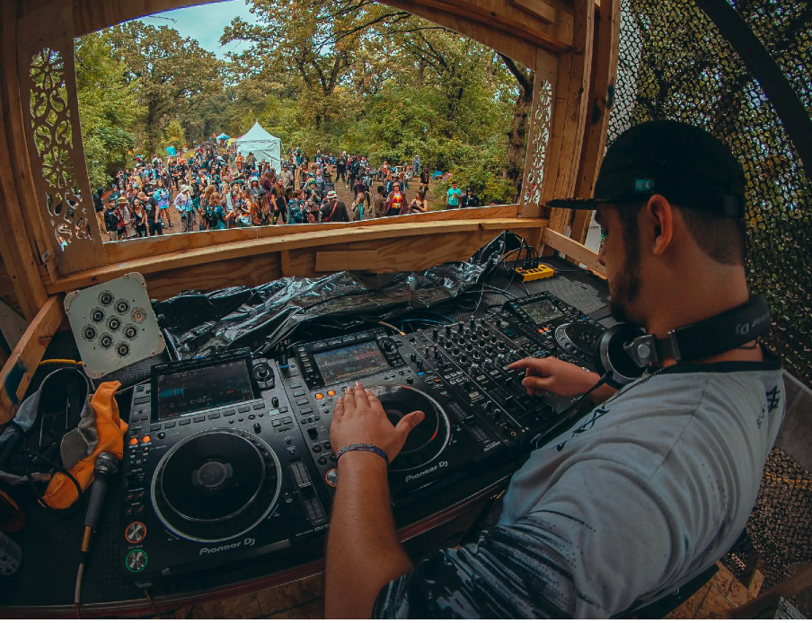
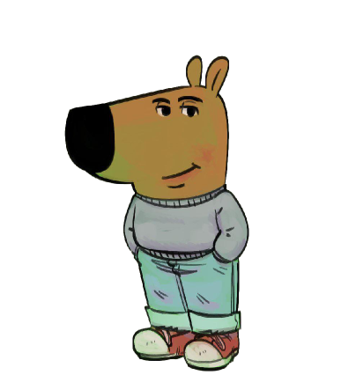
Who Am I?
Multidisciplinary artist of 15 years
• DJ/VJ/Producer
• Encanti Music Academy Alumni
• St. Cloud native
• pretty chill guy

Slide 3
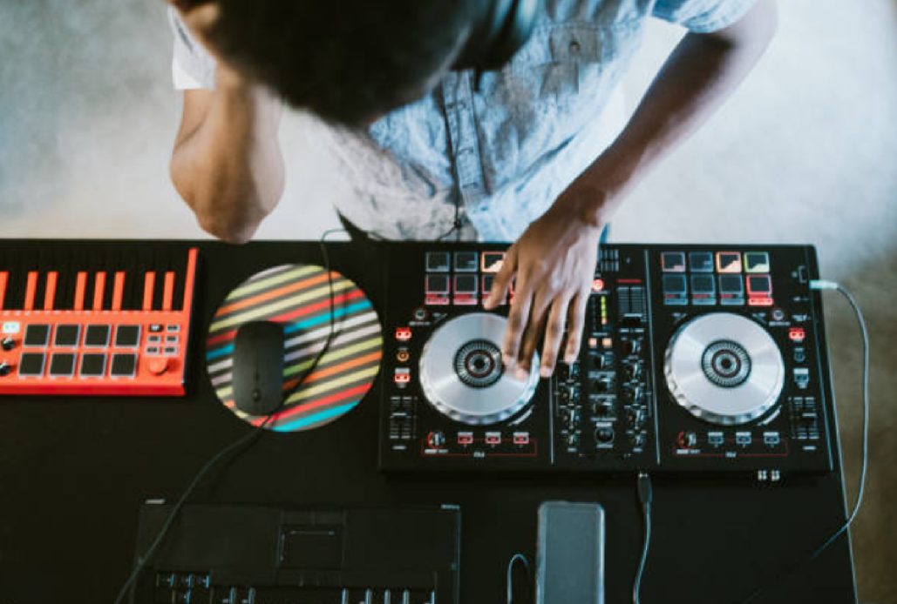
What You’ll Be Able to Do
• Prepare tracks in Rekordbox
• Load music on club gear
• Match BPM
• Perform a basic mix
• Practice at home confidently

Slide 4

What You Need
• Computer
• Headphones/Speakers
• Music files
• Rekordbox installed
• USB drive
• Optional: controller

Slide 5
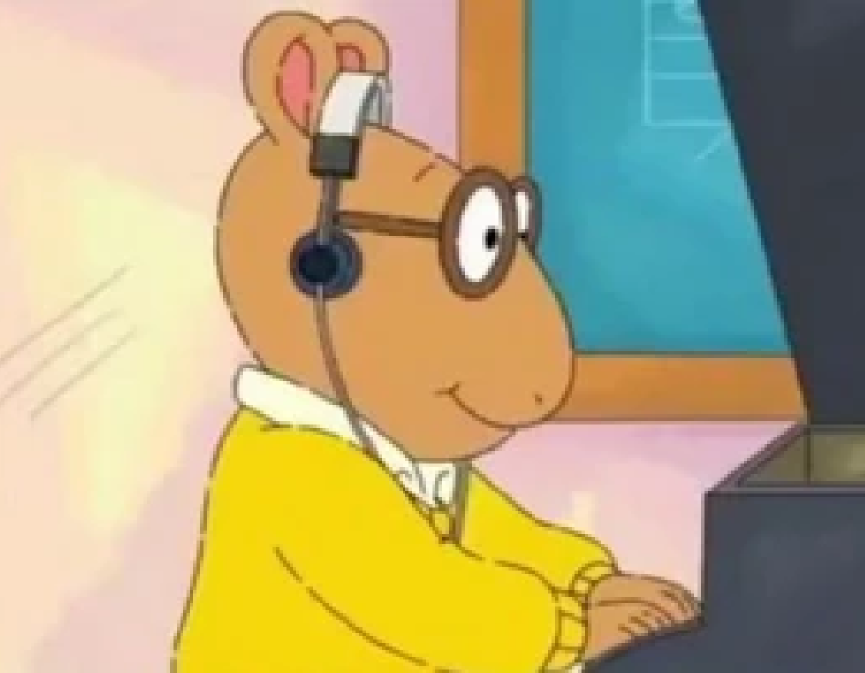
DJ Workflow
• Get music
• Prep tracks
• Make playlist(s)
• Export
• Mix

Slide 6
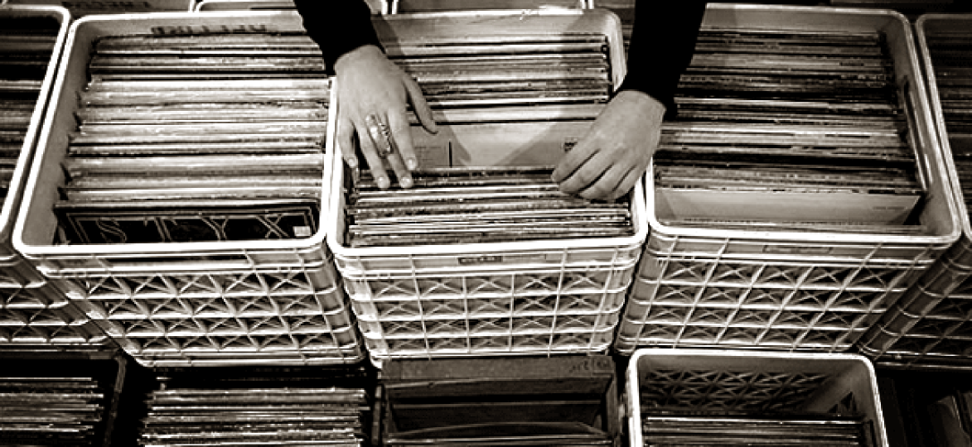
Finding Music
• Soundcloud
• Bandcamp
• Beatport
• Itunes
• Record labels
• Music Collectives

Slide 7

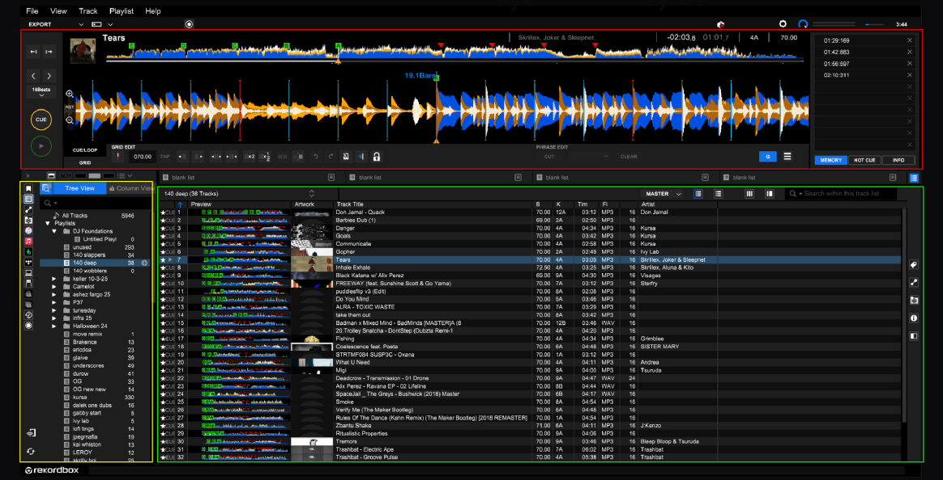
Rekordbox
• Player
• CUE/LOOP and GRID
• Playlists
• Library

Slide 8
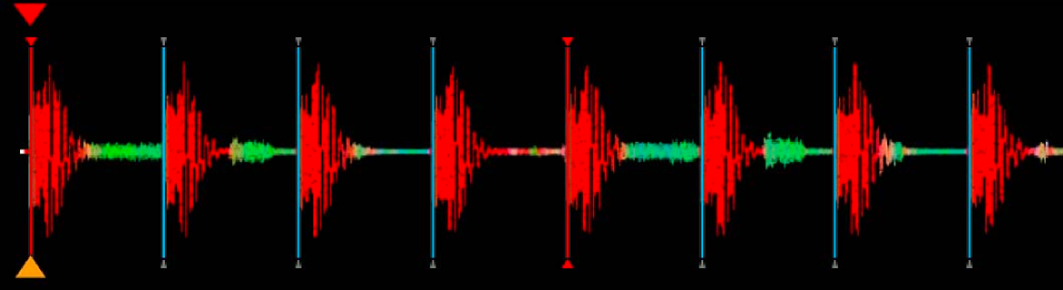
Beatgrids & BPM
• Beatgrid = timing map
• Red line = first beat
• BPM must be correct

Slide 9
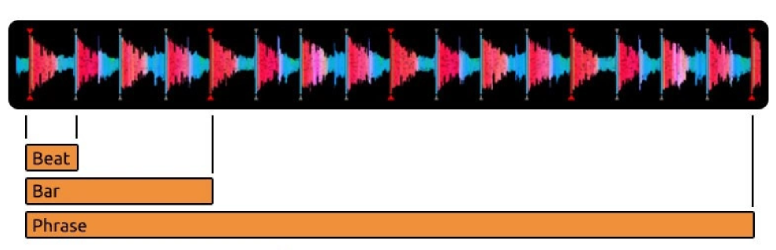
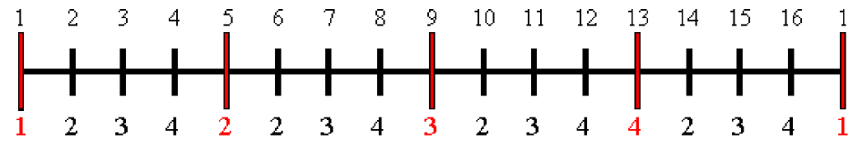
Beats, Bars, and Phrases
• Beat = steady pulse
• 4 beats = 1 bar
• Bars repeat in groups
• Groups form phrases
• Most phrases = multiples of 4 (e.g., 4, 8, 16, etc.,)

Slide 10
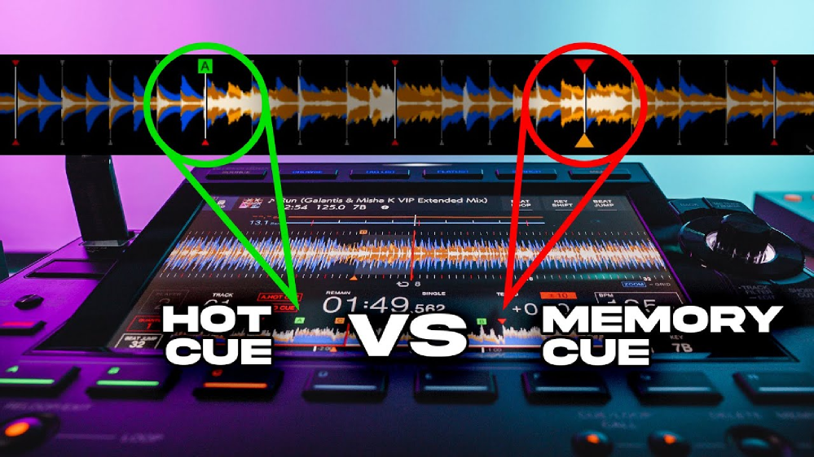
Cue Points
• Cue = bookmark
• Hot Cue = play from here
• Memory Cue = jump to here

Slide 11

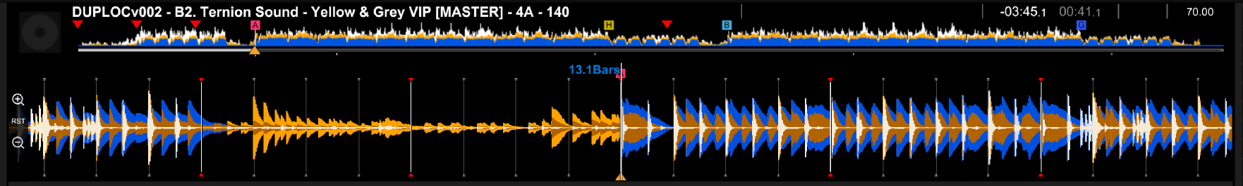
Setting Cues
• Hot Cues A-D = drop
• Hot Cues E-H = mix out
• Memory Cue = mix in

Slide 12
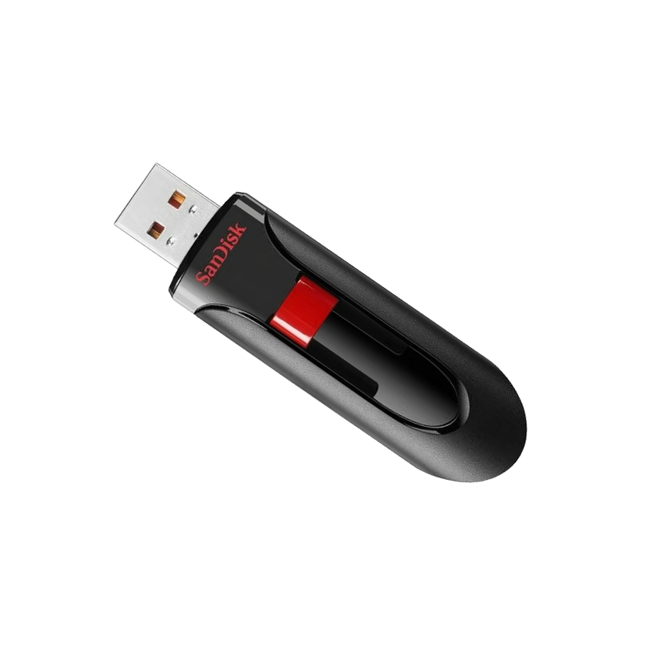
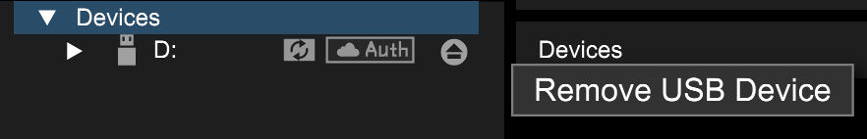
Exporting to USB
• Create playlist(s)
• Check device settings
• Export playlist or folder to USB
• *EJECT DRIVE BEFORE REMOVAL*
(extremely important)
Notes:
failing to eject the flash drive before removing it from the computer will result in it becoming corrupted and needing to be reformatted to load into a player again, that means you will have to delete everything on the drive and re-export your music again before you can use it with a player

Slide 13
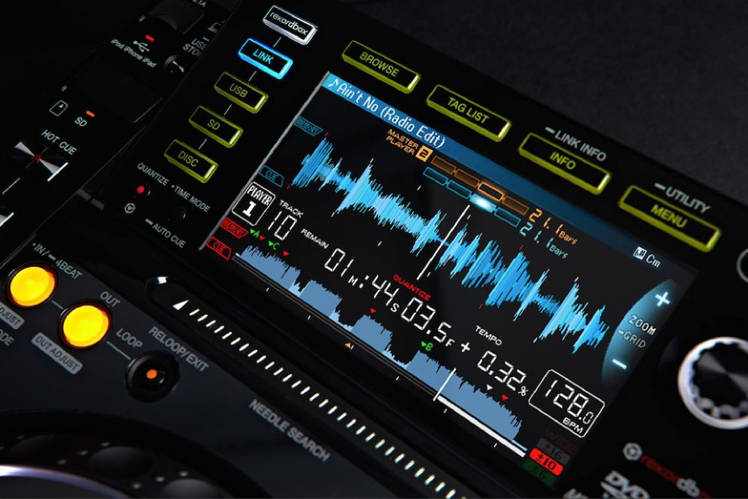
Player Basics (CDJ / XDJ)
• Play / Cue
• Hot Cues
• Jog wheel
• Cue/Loop Call
• Tempo slider
• Browse knob
• USB Select / Eject

Slide 14
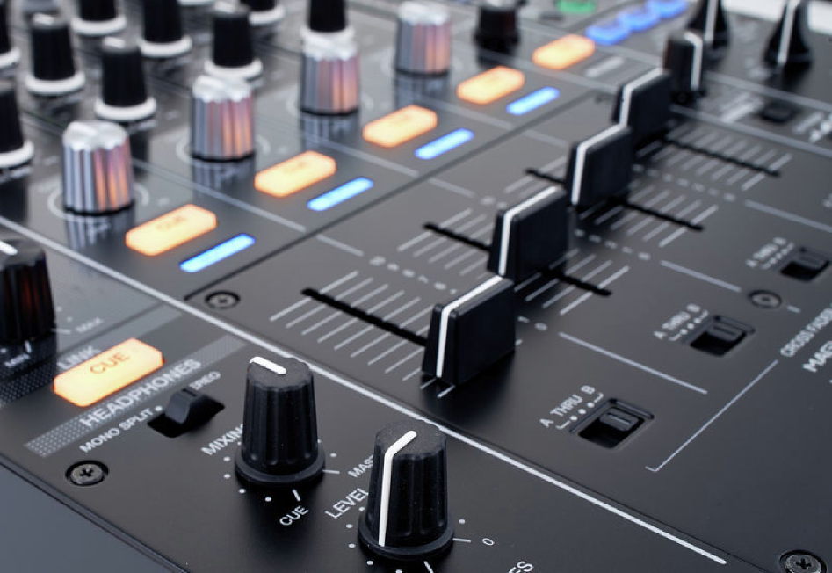
Mixer Basics
• Channel faders
• Headphone Cue = audition
• Color FX / FX
• EQ: lows / mids / highs

Slide 15


Slide 16
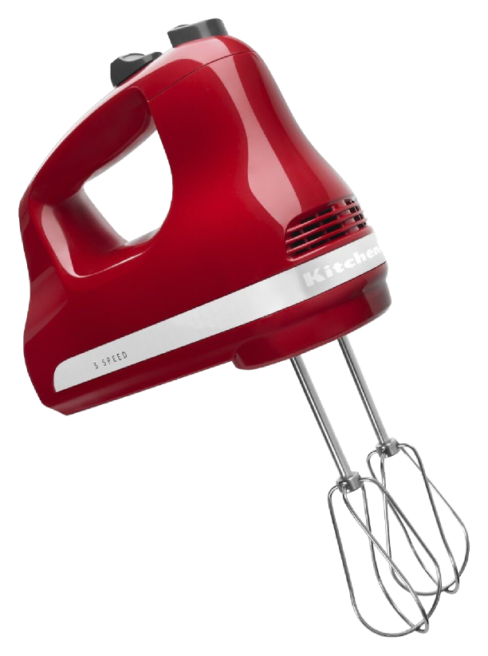
The First Mix
• Track A playing
• Find Track B
• Audition in Headphones
• Start Track B on phrase
• Balance w/ EQ / Volume
• Fade out Track A by end of phrase

Slide 17
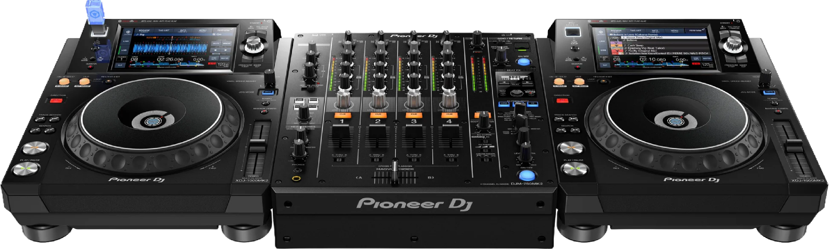
Practice & Next Steps
• Prep 10-15 tracks
• Mix A → B → C
• Repeat basic mix
• Come to open decks!!

Slide 18
Take It Further
• Slam Academy DJ course
• Attending shows
• Attending festivals
• History of DJing
• Recording a mix
• Uploading a mix
• Connecting with promoters
• Connecting with other DJs
• Watching iconic sets on youtube
• Incorporating live instruments
• Manual beatmatching by ear
• Harmonic mixing (Camelot wheel)
• Cue based live remixing
• Loop-based transitions
• Tempo and genre jumps
• Library organization strategies
• Set planning vs. freestyle
• Performance psychology
• Mixing with Vinyl
• Music Produciton

Slide 20

Q&A

Slide 21
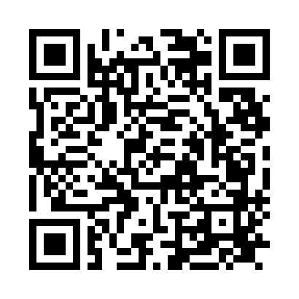
Resources
templeoflum.github.io/dj-foundations-resources
Scan for music sources, software, tutorials & more

